Slide 1
St. Lucia
The Roof is On Fire
Client Project
Antoine, Bryce, Christopher

Slide 2
Contents
Two Data Science Problems
The Data Processing Approaches
The First Approach - Manual Labeling
The Second Approach
Evaluation
Notes:
1. Problems
2. The Approaches
3. Prob 1 Challenges & Prob 2 Challenges
4. Prob 1 Solutions & Prob 2 Solutions
5. Practical Applications of Solutions

Slide 3
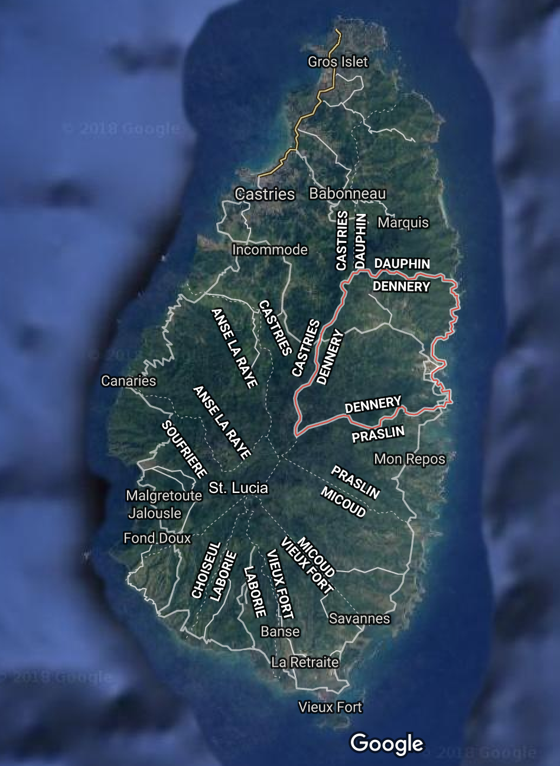
About Dennery and the Two Problems
Dennery, St. Lucia is a fishing village along the Atlantic Ocean side of St. Lucia.
Help St. Lucia prepare for next hurricane season by predicting rooftop quality and integrity using drone image to prioritize interventions.
2 Problems:
Classify objects (roof or not)
Determine Rooftop Quality

Slide 4

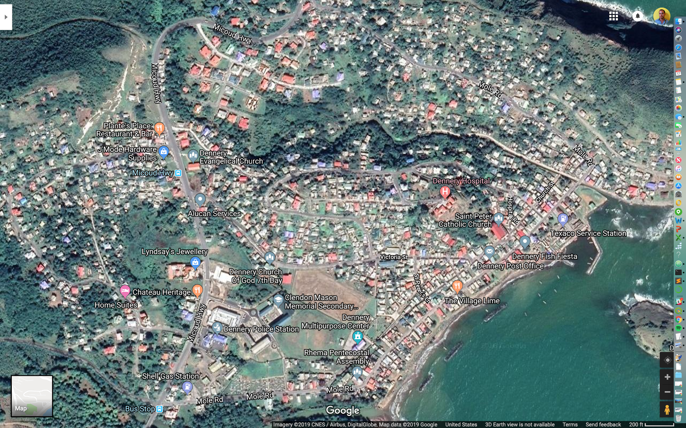
Data on Dennery
Data provided:
Drone images of Dennery
3,519,622,414 bytes
RGB
Elevation - Digital Terrain Model (DTM)
Lidar - Digital Surface Model (DSM)
DSM - DTM = Height
GIS Layers from OpenStreetMap and Charim
Containing .tiff, .aux, .prj files
Metadata of Geo Coordinates

Slide 5
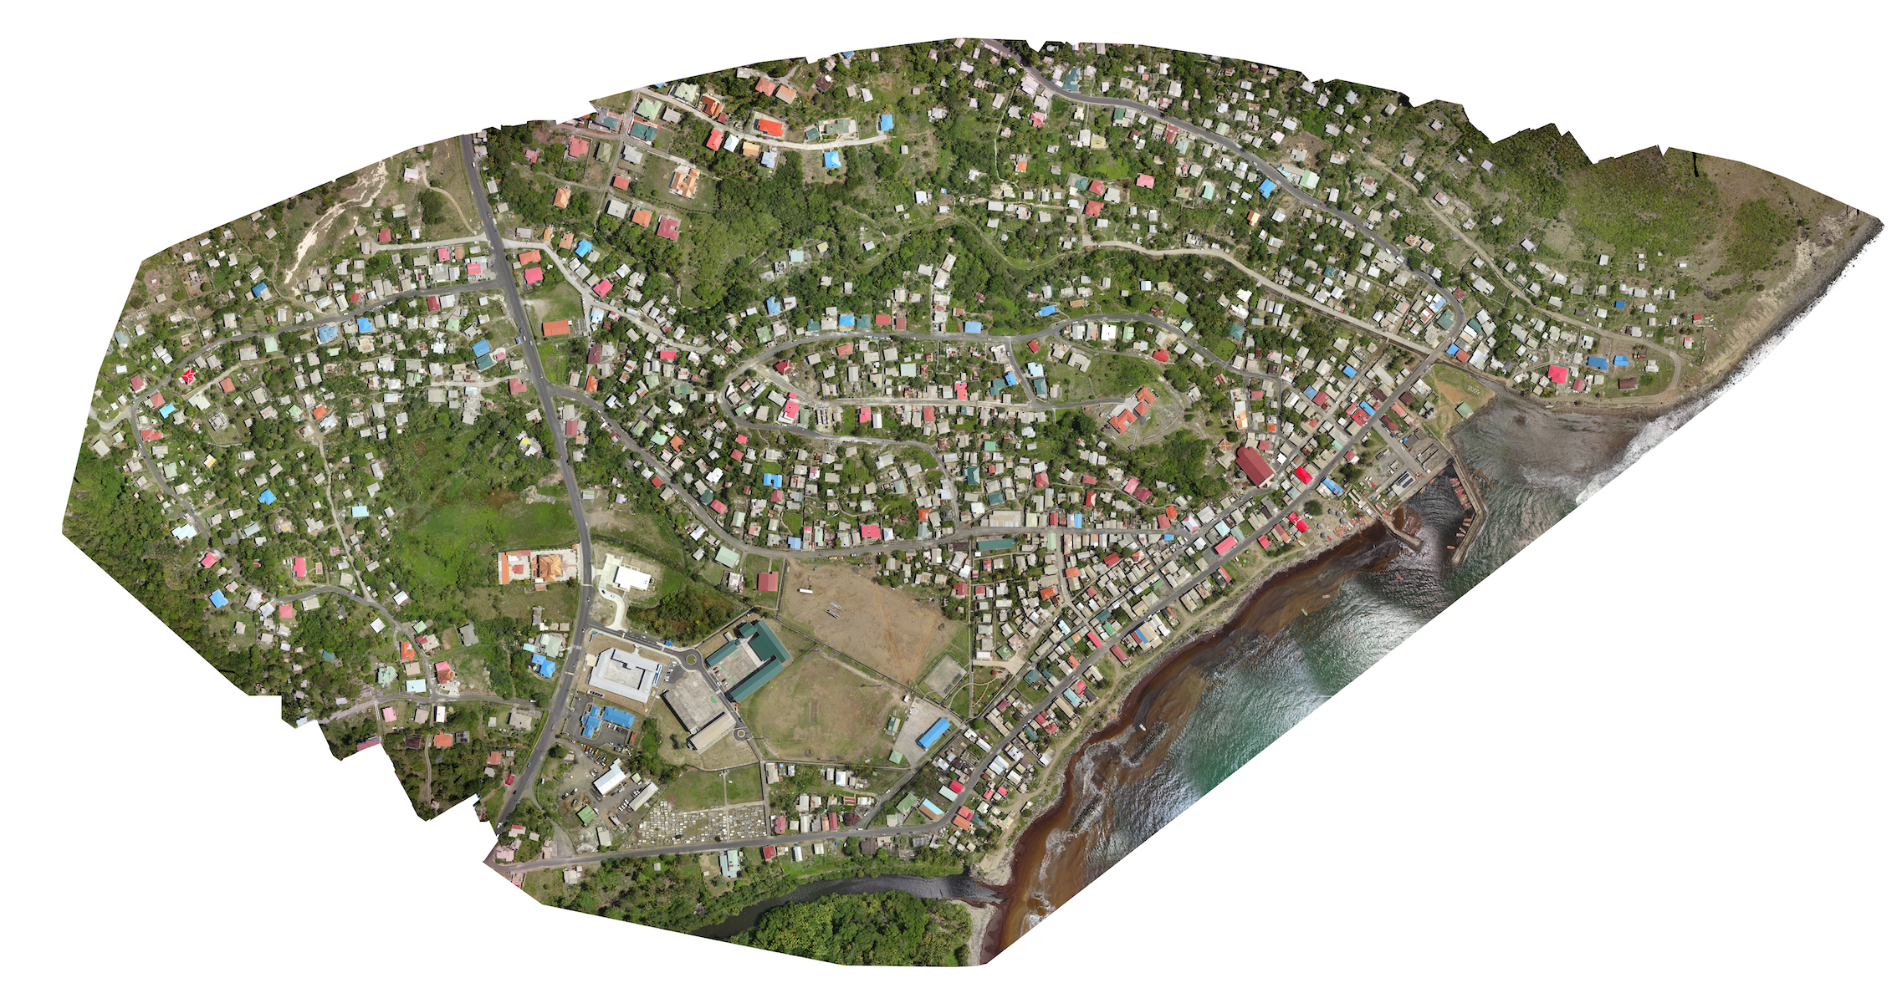
The Image - Dennery

Slide 6
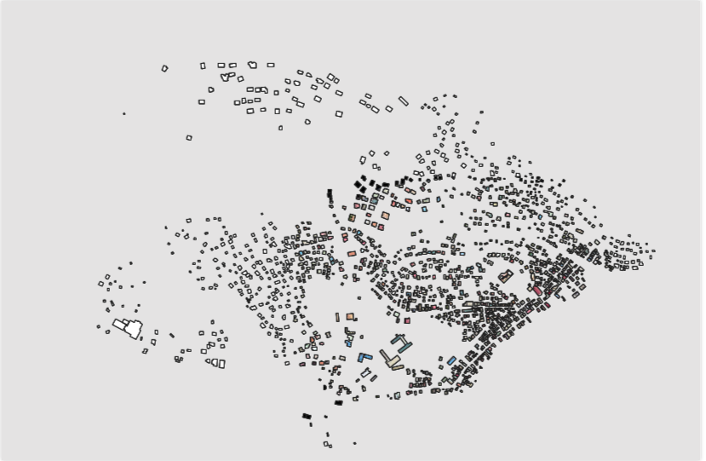
The Roofs

Slide 7

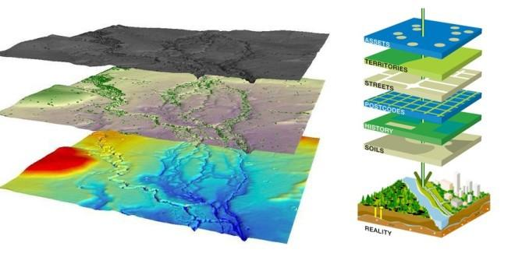
Challenges
GIS
Image Processing
Deep learning
How does GIS work?
Which libraries / systems to use?
Which neural networks to work with?

Slide 8
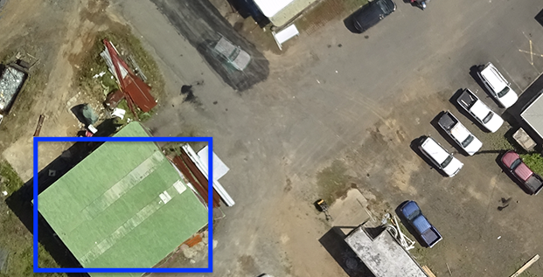
The First Approach - Manual Labeling
Create Tiles
Label data
Manually to Classify Quality
Train Convolutional Neural Network
Classify

Slide 9
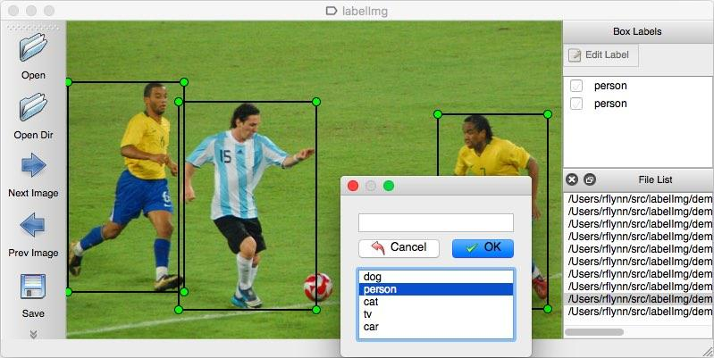
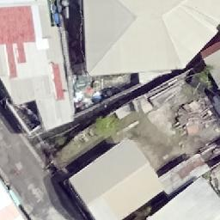

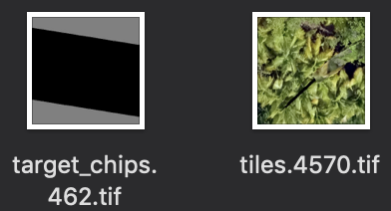
Hand-labelling for Condition Classification
Train on local GPU
(Mask RCNN Inception V2)
Map tiles from QGIS
LabelIMG API
Imagery into QGIS
TensorFlow - RCNN for Object Recognition
Multi-class labeling of tiles

Slide 10
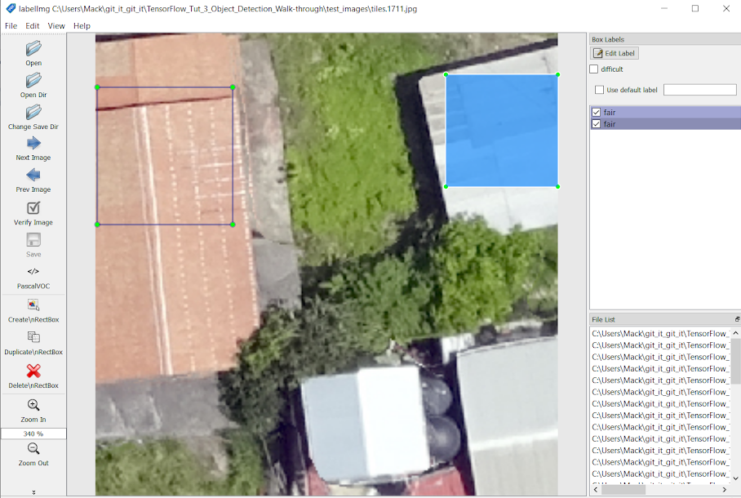
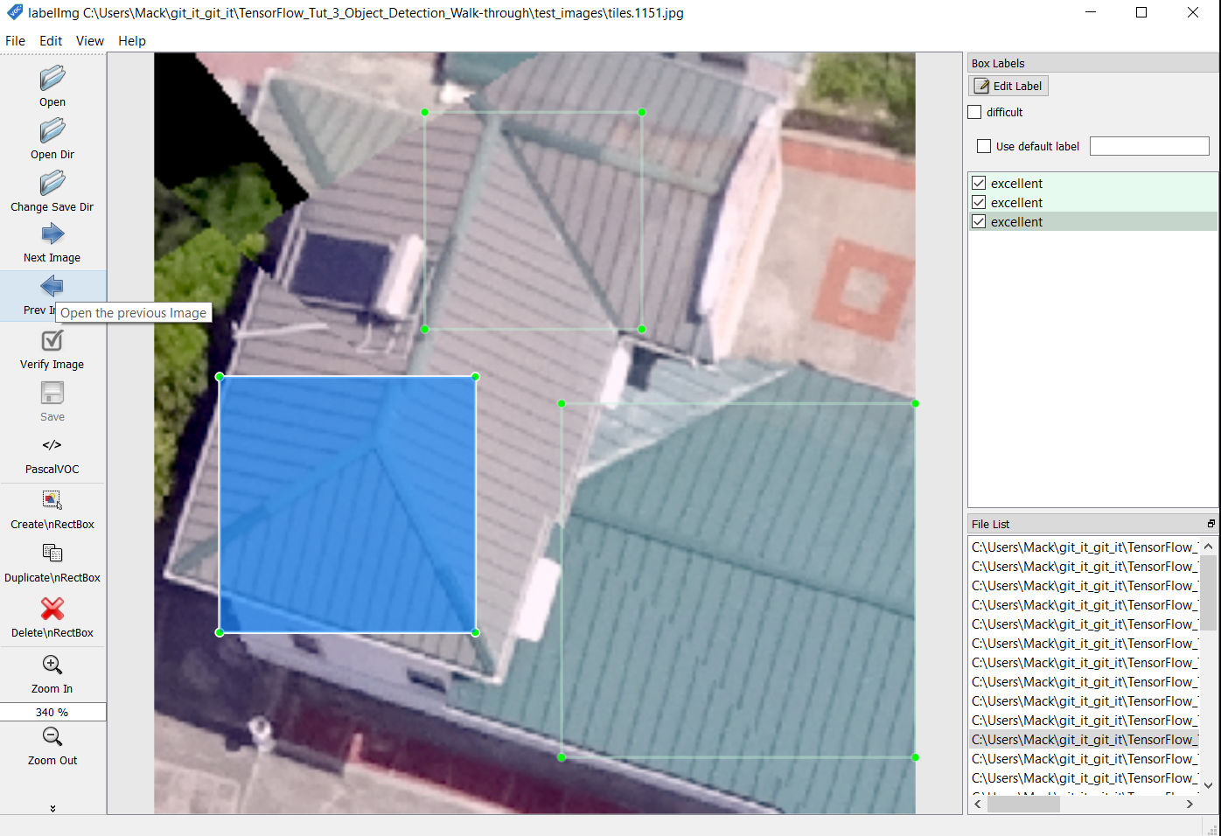
Label IMG process
Set bounding box over class example

Slide 11
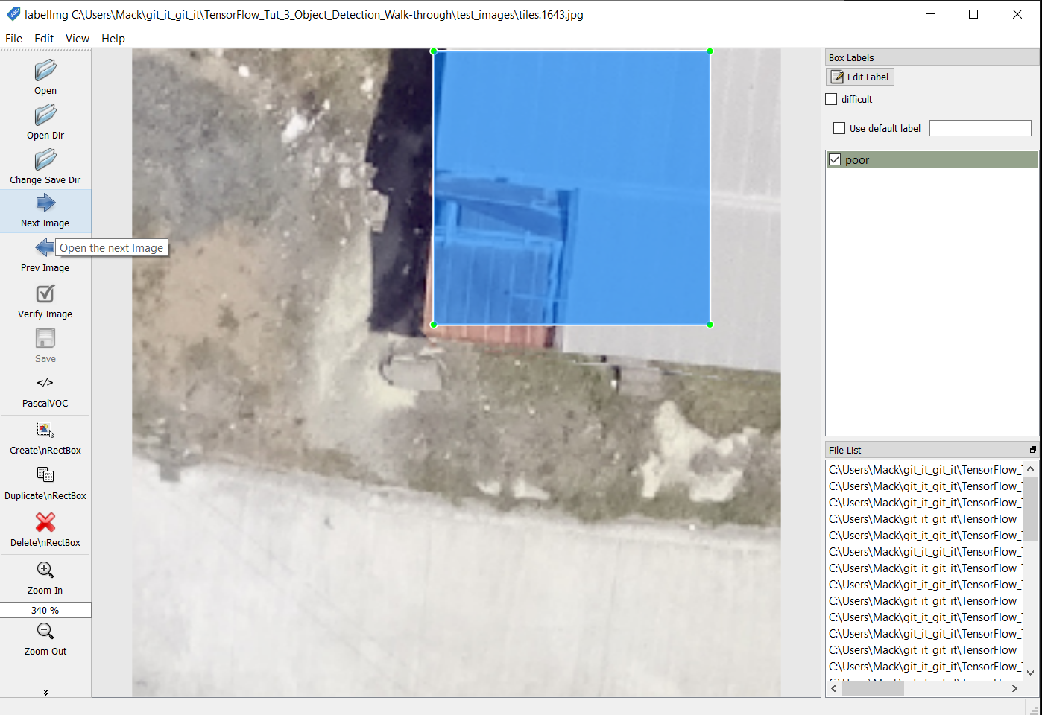
Label IMG process
1 - Poor
2 - Fair
3 - Good
4 - Excellent

Slide 12
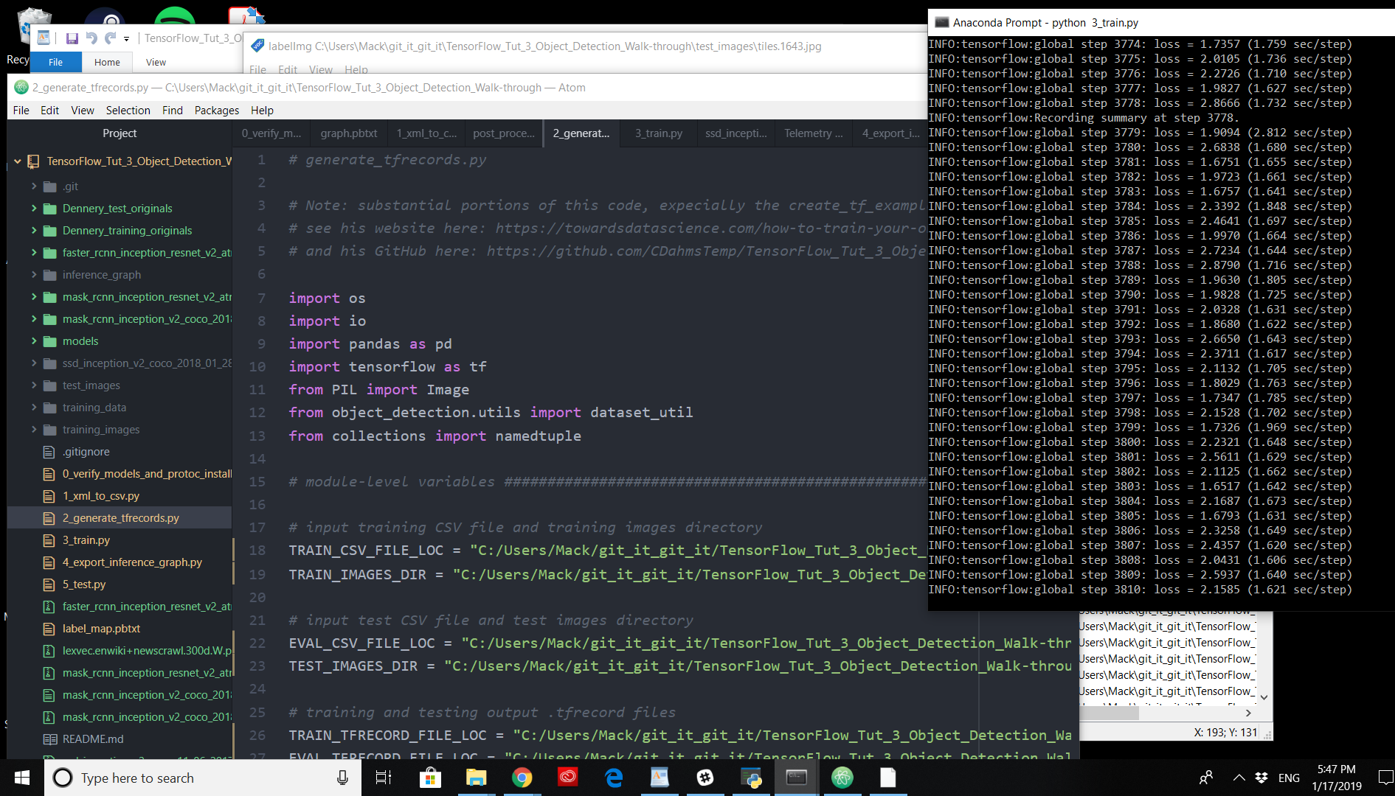
Training with Mask RCNN
A slow, but accurate model
Very “greedy”

Slide 13
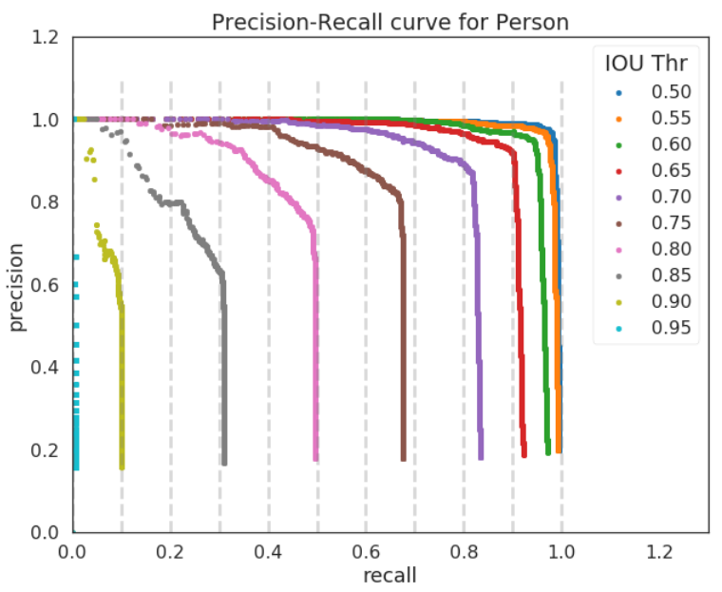
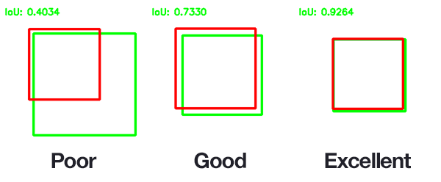
Current Issue - TensorFlow not producing key params
Intersection over Union
Score Threshold

Slide 14
The Second Approach
Process Images
Extract ‘ground truth’ labels
Associate labels with image
Tile image / labels

Slide 15
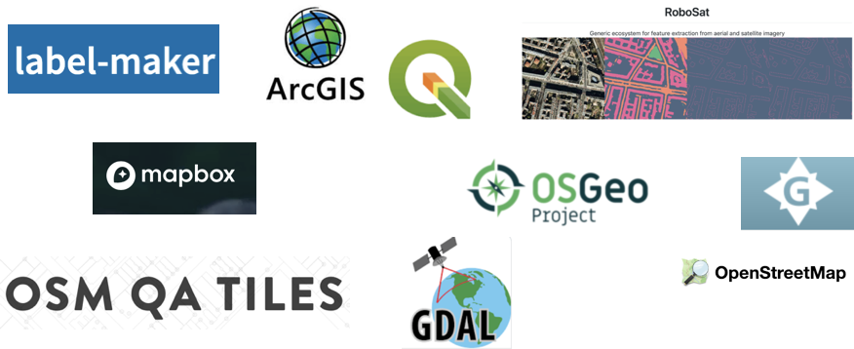
Automatic Labeling of Geospatial Data
Notes:
G - Geo Fabric - provides building labels

Slide 16
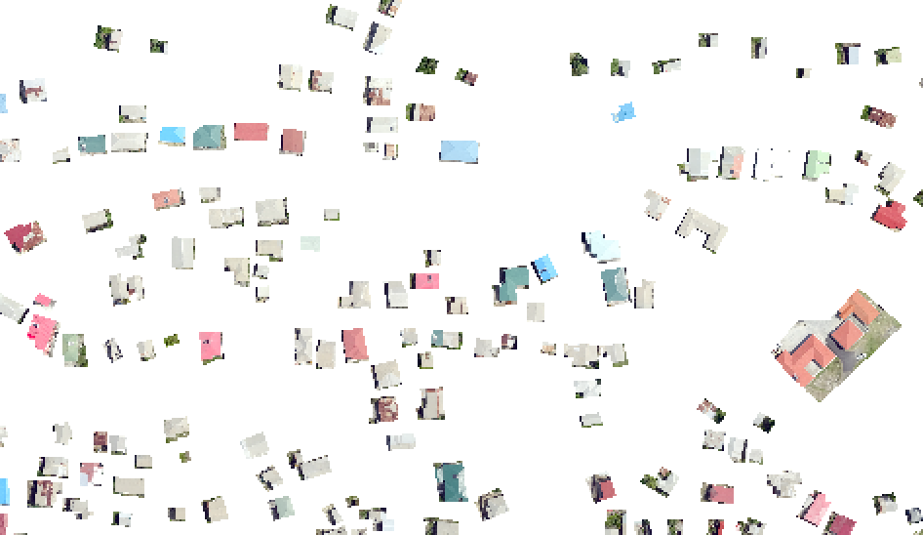


Semi-automatic labelling of Geospatial Data
TO AWS AND
MODEL
(Keras ResNet50)
Shapefile from OSM
Mask into QGIS
Imagery into QGIS
Create vector mask (Fiona & Rasterio)
Tile mask and Image

Slide 17
The Model
ResNet50
50 layer residual neural network
Pre-trained on ImageNet datasets
Suitable for working with geospatial data
Run on an AWS GPU instance (p2.xlarge)
Using the Keras API

Slide 18
Evaluating Process
Data
Understanding Data
Manipulating / Using Drone Data
Model
Which models
How to model
Evaluating models

Slide 19
Questions?
The End

